Slide 1

Statistical analysis of the effects of sample drying on metabolite concentrations in pumpkin leaves
Goals: Carry out statistical tests with false discovery correction to identify metabolites, which are significantly altered between the two workup methods
Topics:
Statistical analysis (2 classes)
False discovery rate
Power analysis
Statistics

Slide 2

Identify the effects of sample drying?
Use DATA: Pumpkin data 2.csv
Steps:
Use t-Test to compare metabolite means for each treatment
Correct for the false discovery rate (FDR) adjusted p-value
Estimate FDR (q-value)
Visualize:
Relationship between p-value and FDR adjusted p-value
Relationship between FDR adjusted p-value and q-value
Box plots for highest and lowest p-value metabolites
Questions:
When should you use a one-sample, two-sample or paired t-test, ANOVA?
Statistics

Slide 3
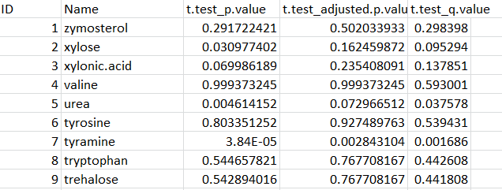
Hypothesis Testing Strategies
One sample t-Test is used to compare single value to a population mean
Two sample t-Test is used to compare 2 independent populations
Paired t-Test is used to compare the same population (intervention, repeated measures)
One-way ANOVA (analysis of variance) is used to compare n populations for one factor
Two-way ANOVA is used to compare n populations for 2 factors
Repeated Measures ANOVA (e.g time course, intervention, cross-over)
ANCOVA (analysis of covariance) is used to adjust n populations for covariate (typically continuous) prior to testing for n factors
Mixed effects models are versatile analogue to linear model or ANOVA/ANCOVA and typically used to adjust for covariates or variance due to repeated measures
*All of the above are parametric tests, and some of which have non-parametric analogues
Statistics

Slide 4
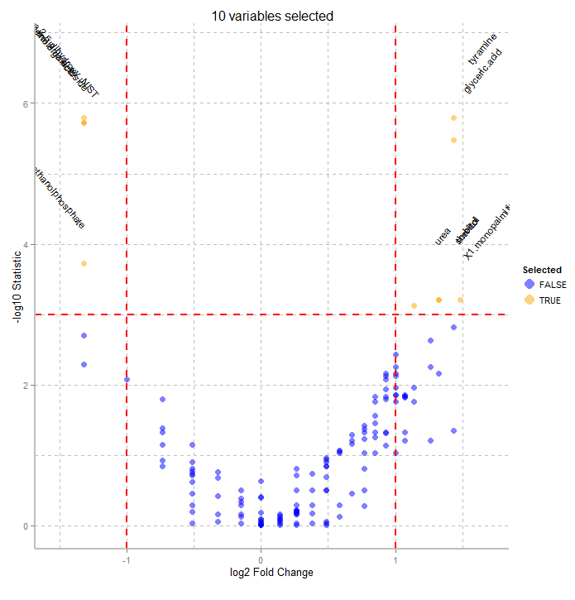
Question:
Identify all significantly altered metabolites between the two treatments at p<0.05 and FDRp<0.05
Statistics

Slide 5
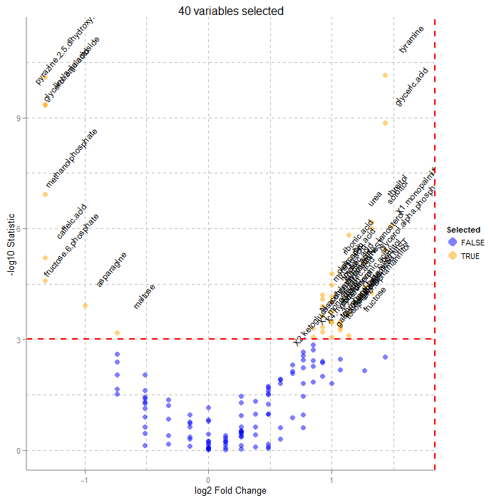
Answer:
Identify all significantly altered metabolites between the two treatments at p<0.05
Statistics

Slide 6
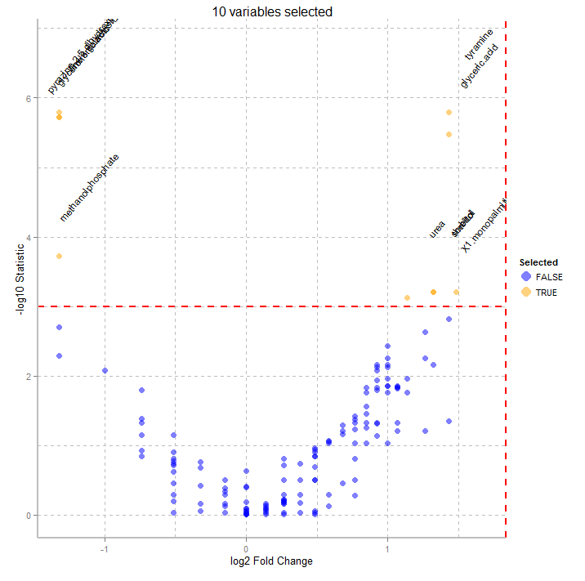
Answer:
Identify all significantly altered metabolites between the two treatments at FDRp<0.05
Statistics

Slide 7
Volcano Plot
Importance based on magnitude of change and significance
Statistics

Slide 8
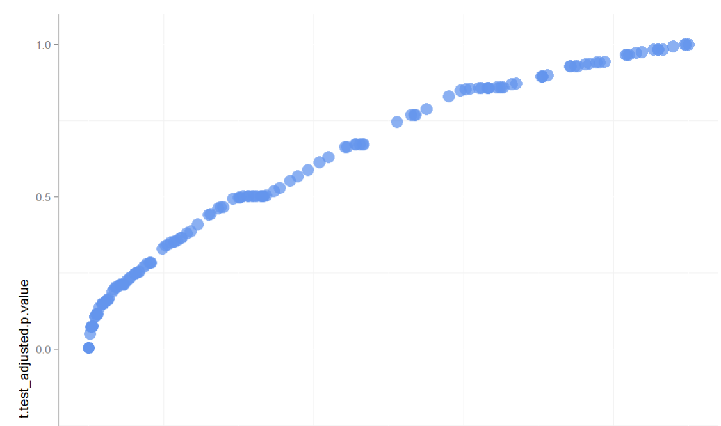
Question:
What is the relationship between p-values and FDR adjusted p-values, what is the most and least conservative FDR method?
Statistics

Slide 9
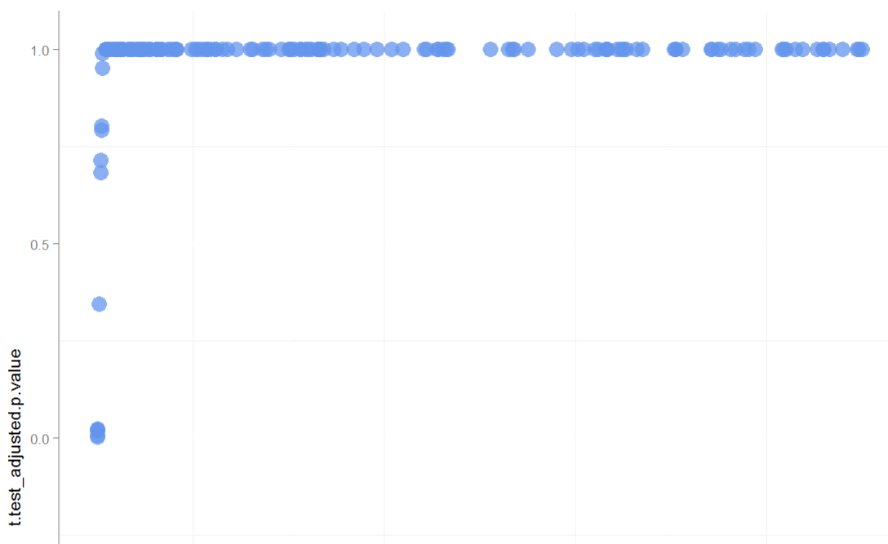
Answer:
What is the relationship between p-values and FDR adjusted p-values, what is the most and least conservative FDR method?
Benjamini & Hochberg (1995) (“BH”)
Accepted standard
FDR adjusted p-value
Statistics
Bonferroni
Very conservative
adjusted p-value = p-value*# of tests
(e.g. 0.005 * 148 = 0.74 )
p-value

Slide 10
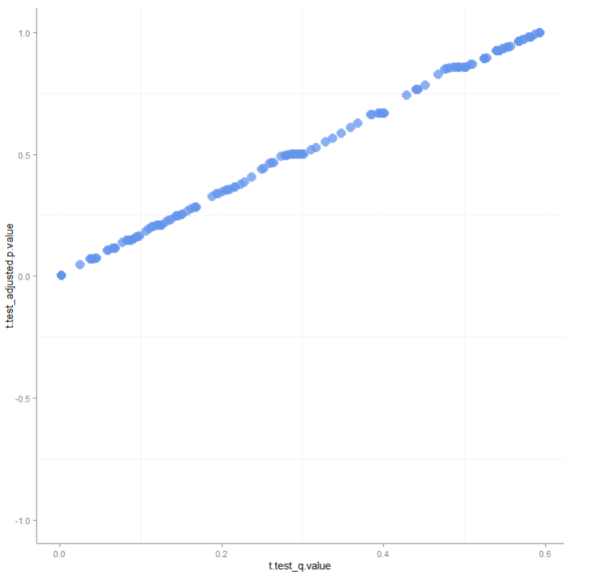
p-value vs. q-value
q-value can be used to select appropriate p-value cut off for an acceptable FDR for multiple hypotheses tested
q=0.05 nicely matches assumptions of p=0.05 for multiple hypotheses tested
q-value≤0.2 can be acceptable
FDR adjusted p-value
Statistics
q-value

Slide 11
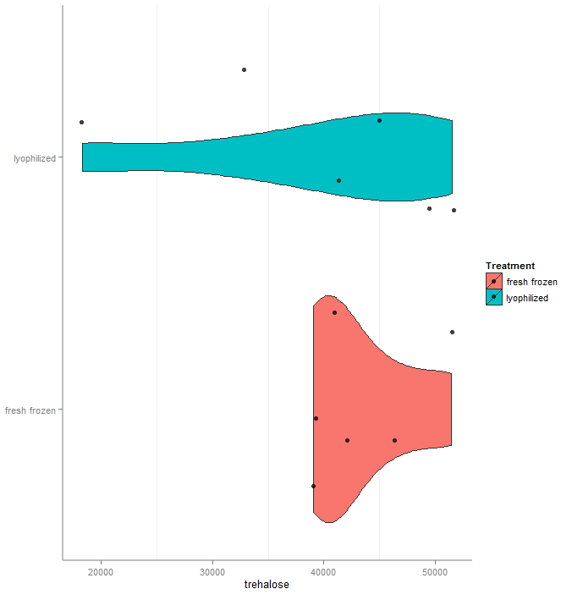
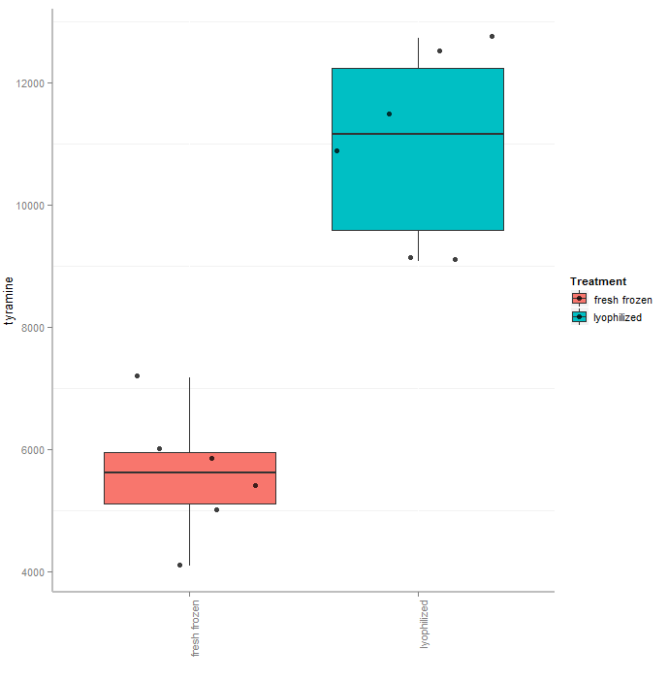
Question:
Characterize the effect size between dry and fresh treatments for any two metabolites of interest
Statistics

Slide 12
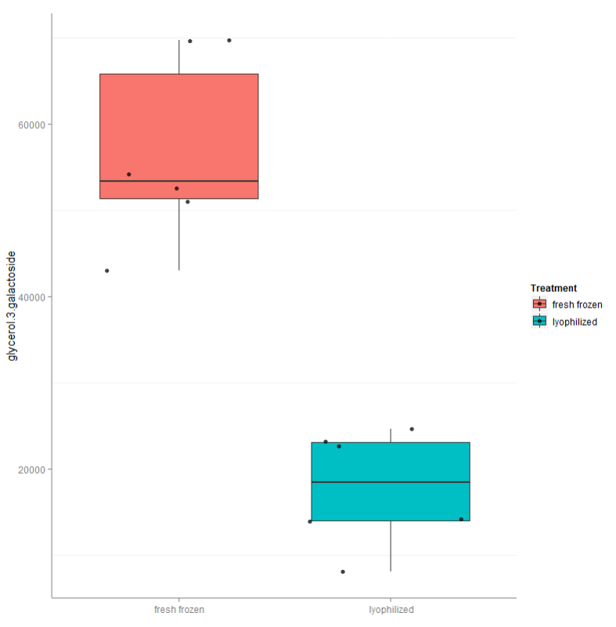
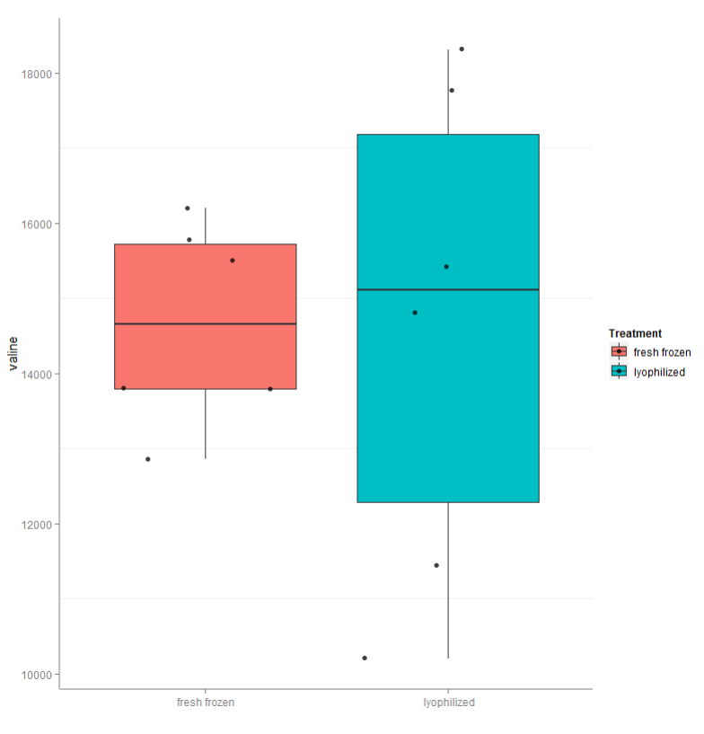
Answer:
Characterize the effect size between dry and fresh treatments for any two metabolites of interest
Effect size: small
large
Statistics
valine
glycerol 3 glactoside

Slide 13
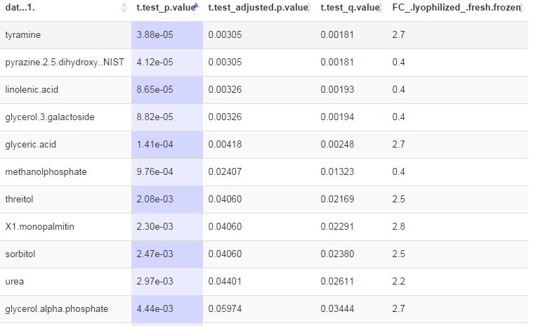
Effect of drying is minimal
However the following metabolites are significantly altered between the two work up methods
Statistics

Slide 14
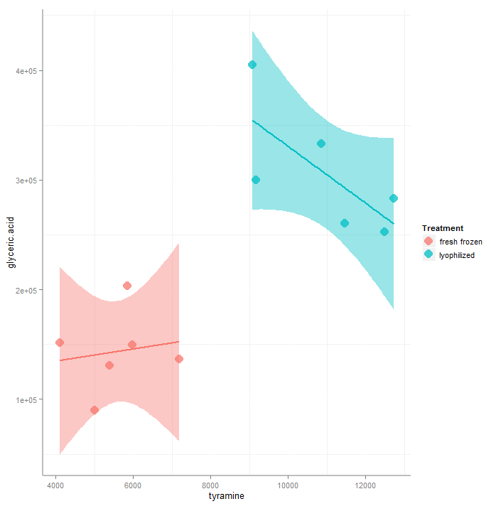
Consequence of workup methods
Different methods can affect the apparent relationships between metabolites
Analysis of method performance based on metabolite physical properties can be used to spot method bias.
Statistics

Slide 15
Power analysis
Goals: Use power analysis to plan a follow up experiment to detect differences in metabolites due to drying treatment
Steps:
Calculate effect size and power for three metabolites
Given the observed effect size calculate the number of samples needed to reach 80% power
Questions:
How would you take FDR in to account?
Statistics

Slide 16
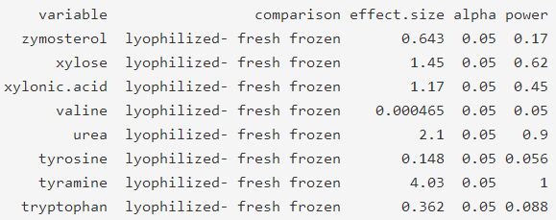
Question:
Calculate the effect size and power for any metabolites of interest
Statistics

Slide 17
Answer:
Calculate the effect size and power for any metabolites of interest
Ability to detect a difference when it exists (control false negative rate)
Scaled difference in means between treatments
Statistics
Probability of being wrong when spotting a difference (control false positive rate)

Slide 18
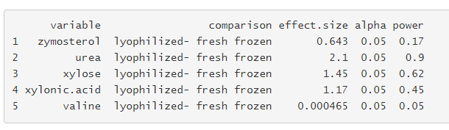


Utility of power analysis
Identify optimal number of samples to detect differences at some p-value and power in follow-up experiments, given effect sizes calculated from the current experiment
Statistics

Slide 19



Utility of power analysis
The minimum fold change (FC) in means observable by the study can be calculated using RSD and estimated effect size to reach 0.8 (80%) power given the population size
RSD = 0.21 and effect size (EF) =1.2
We can observe a minimum of a 38% change in means at 0.8 power (p= 0.05).
Statistics

